Slide 1
CHAPTER # 03: PROCESS
BSCS-IV

Slide 2
CONTENTS
Process Concept
Process Scheduling
Operations on Processes
Interprocess Communication
IPC in Shared-Memory Systems
IPC in Message-Passing Systems
Communication in Client– Server Systems

Slide 3
PROCESS!
Program in Execution

Slide 4
01
PROCESS CONCEPT

Slide 5
PROCESS CONCEPT
A process is a running program that serves as the foundation for all computation.
Process refers to an entity that helps in representing the fundamental unit of work that must be implemented in any system.
PROCESS: Active Entity
PROGRAM: Passive Entity
Process names in other systems:
Batch System: Jobs
Time shared systems: Tasks

Slide 6
PROCESS COMPONENTS/SECTIONS
A program can be segregated into four pieces when put into memory to become a process:
Stack
Heap
Text
Data.

Slide 7
PROCESS COMPONENTS/SECTIONS
Stack
Temporary data like method or function parameters, return address, and local variables are stored in the process stack.
Heap
This is the memory that is dynamically allocated to a process during its execution.
Text
This comprises the contents present in the processor’s registers as well as the current activity reflected by the value of the program counter.
Data
The global as well as static variables are included in this section.

Slide 8

PROCESS COMPONENTS/SECTIONS

Slide 9
PROCESS STATES
When a process runs, it goes through many states. Distinct operating systems have different stages, and the names of these states are not standardised. In general, a process can be in one of the five states listed below at any given time.

Slide 10
PROCESS LIFECYCLE or STATES
1. Start
When a process is started/created first, it is in this state.
2. Ready
Here, the process is waiting for a processor to be assigned to it. Ready processes are waiting for the operating system to assign them a processor so that they can run. The process may enter this state after starting or while running, but the scheduler may interrupt it to assign the CPU to another process.

Slide 11
PROCESS LIFECYCLE or STATES
3. Waiting
If a process needs to wait for any resource, such as for user input or for a file to become available, it enters the waiting state.
4. Terminated or Exit
The process is relocated to the terminated state, where it waits for removal from the main memory once it has completed its execution or been terminated by the operating system.

Slide 12
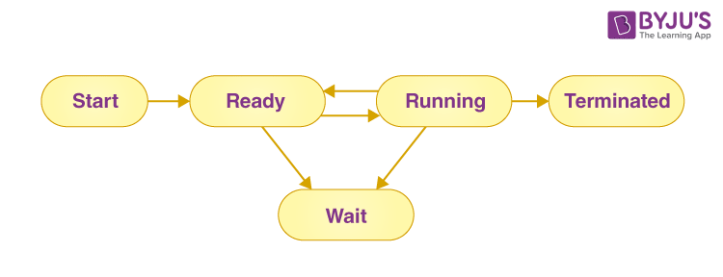
PROCESS LIFECYCLE or STATES

Slide 13
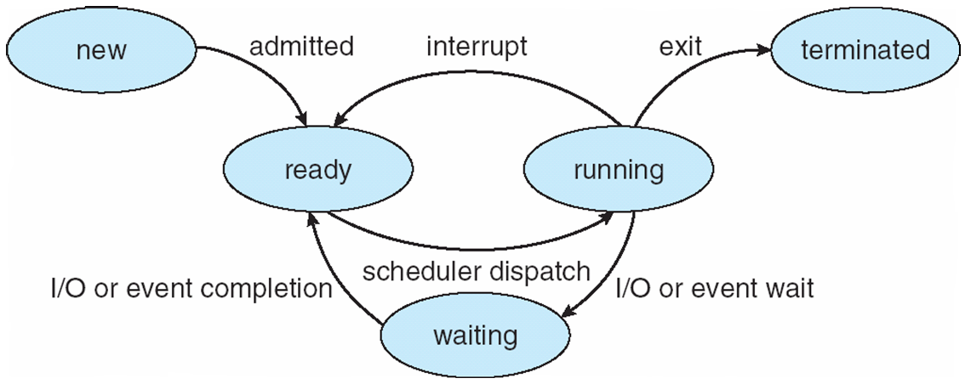
PROCESS LIFECYCLE or STATES

Slide 14
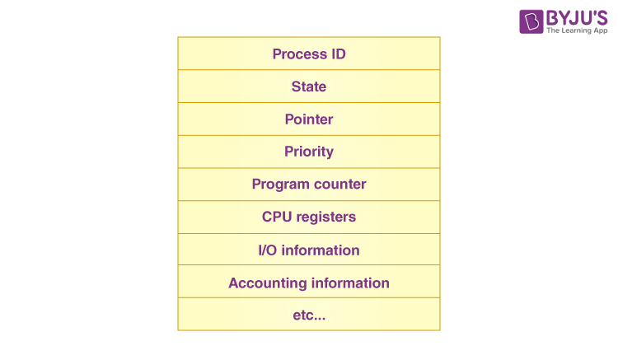
PROCESS CONTROL BLOCK (PCB)
Task Control Block
Every process has a process control block, which is a data structure managed by the operating system. An integer process ID (or PID) is used to identify the PCB.
PCB stores all of the information required to maintain track of a process.

Slide 15
PROCESS CONTROL BLOCK (PCB)
1. Process state
The process’s present state, such as whether it’s ready, waiting, running, or whatever.
2. Process privileges
This is required in order to grant or deny access to system resources.
3. Process ID
Each process in the OS has its own unique identifier.
4. Pointer
It refers to a pointer that points to the parent process.

Slide 16
PROCESS CONTROL BLOCK (PCB)
5. Program counter
The program counter refers to a pointer that points to the address of the process’s next instruction.
6. CPU registers
Processes must be stored in various CPU registers for execution in the running state.
7. CPU scheduling information
Process priority and additional scheduling information are required for the process to be scheduled.

Slide 17
PROCESS CONTROL BLOCK (PCB)
8. Memory management information
This includes information from the page table, memory limitations, and segment table, all of which are dependent on the amount of memory used by the OS.
9. Accounting information
This comprises CPU use for process execution, time constraints, and execution ID, among other things.

Slide 18
PROCESS CONTROL BLOCK (PCB)
10. IO status information
This section includes a list of the process’s I/O devices.
The PCB architecture is fully dependent on the operating system, and different operating systems may include different information.

Slide 19
02
PROCESS SCHEDULING!

Slide 20
PROCESS SCHEDULING
When there are several or more runnable processes, the operating system chooses which one to run first; this is known as process scheduling.
A scheduler is a program that uses a scheduling algorithm to make choices. The following are characteristics of a good scheduling algorithm:
1. For users, response time should be kept to a bare minimum.
2. The total number of jobs processed every hour should be as high as possible, implying that a good scheduling system should provide the highest possible throughput.
3. The CPU should be used to its full potential.
4. Each process should be given an equal amount of CPU time.

Slide 21
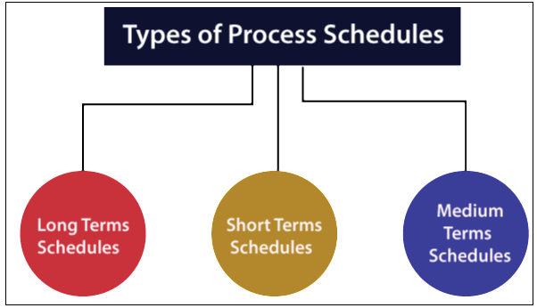
PROCESS SCHEDULERS

Slide 22
PROCESS SCHEDULERS
Long Term Scheduler: - Long term scheduler is also referred to as Job Scheduler. The task of the Long-term scheduler is to select the process from secondary storage and hold them in the ready queue, which is in the primary storage.
Short Term Scheduler: - The task performed by the short-term scheduler is to choose one of the jobs from the ready queue and send it for execution to the CPU. Short Term Scheduler means a CPU scheduler.

Slide 23
PROCESS SCHEDULERS
Medium Term Scheduler: - The Medium-term scheduler is responsible for having the process suspended and resumed. It primarily switches (moving processes from main memory to disk and disk to main memory).
In the medium-term scheduler, swapping is used to increase the performance of the process mix or due to changes in the requirements of memory that have over-engaged available memory that needs memory to be released.

Slide 24
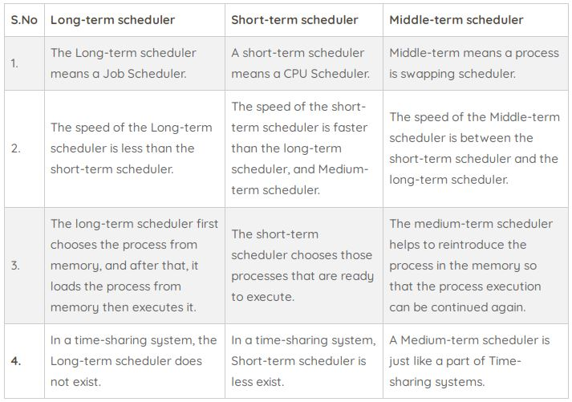

Slide 25
PROCESS QUEUES
The operating system handles a number of queues for a process state.
The process-related to program control block (PCB) is also stored in a queue.
There are various types of queue:
Job Queue
Ready Queue
Waiting Queue

Slide 26
PROCESS QUEUES
Job Queue: - All processes are placed in the job queue at the beginning. It is kept in secondary storage. The long-term scheduler selects a few of the jobs and places them in the primary storage.
Ready Queue: - The primary memory holds the ready queue. In ready queue with the help of the short-term scheduler, we select the job for the execution from the ready queue, and then we will dispatch it to the CPU.

Slide 27
PROCESS QUEUES
Waiting Queue: - In the ready queue, if the process requires doing some operations means any input/output operation to finished its execution, then it is must that the operating system switches the process state from running to the waiting state. The context (Program Control Block) is stored in the waiting18 queue that will be used by the processor when the IO is done.

Slide 28
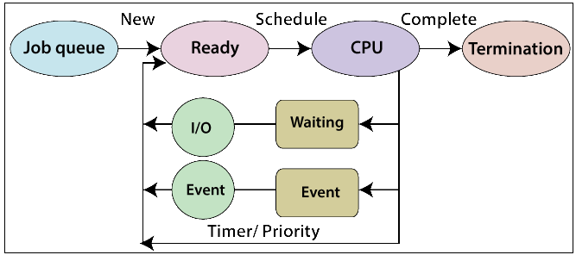
PROCESS QUEUES

Slide 29
CONTEXT SWITCHING
A context switch captures the CPU state (the context) of the current running process and pauses it, then swaps in the state of another process so it can then resume running where it previously left off.

Slide 30
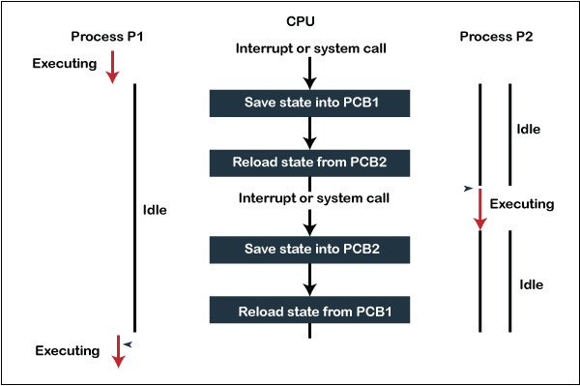
CONTEXT SWITCHING

Slide 31
03
PROCESS OPERATIONS!

Slide 32
OPERATIONS ON PROCESSES
A process may be created by another process using fork().
The creating process is called the parent process and the created process is the child process.
A child process can have only one parent but a parent process may have many children.
Both the parent and child processes have the same memory image, open files, and environment strings. However, they have distinct address spaces.

Slide 33
PROCESS CREATION
Parent process create children processes, which, in turn create other processes, forming a tree of processes
Generally, process identified and managed via a process identifier (pid)
Resource sharing options:
Parent and children share all resources
Children share subset of parent’s resources
Parent and child share no resources

Slide 34
PROCESS CREATION
Execution options
Parent and children execute concurrently
Parent waits until children terminate
Address space
Child duplicate of parent
Child has a program loaded into it

Slide 35
PROCESS CREATION
UNIX examples
fork() system call creates new process
exec() system call used after a fork() to replace the process’ memory space with a new program

Slide 36
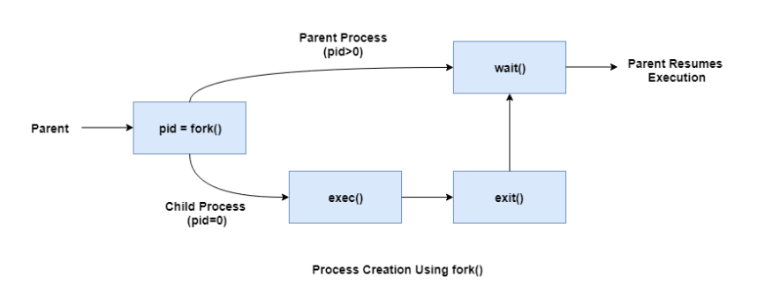
OPERATIONS ON PROCESSES
PROCESS CREATION
A diagram that demonstrates process creation using fork() is as follows:

Slide 37
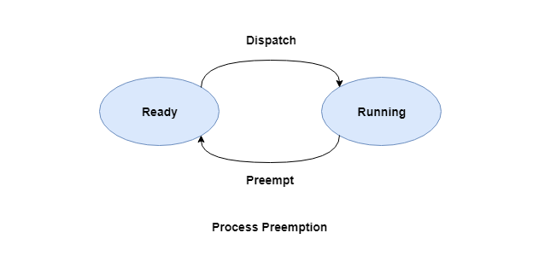
PROCESS OPERATIONS
Process Preemption
An interrupt mechanism is used in preemption that suspends the process executing currently and the next process to execute is determined by the short-term scheduler. Preemption makes sure that all processes get some CPU time for execution.
A diagram that demonstrates process preemption is as follows −

Slide 38
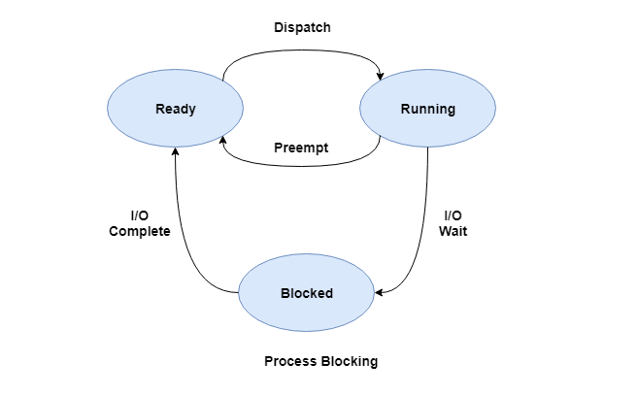
PROCESS OPERATIONS
Process Blocking
The process is blocked if it is waiting for some event to occur. This event may be I/O as the I/O events are executed in the main memory and don't require the processor. After the event is complete, the process again goes to the ready state.
A diagram that demonstrates process blocking is as follows −

Slide 39
PROCESS OPERATIONS
Process Termination
After the process has completed the execution of its last instruction, it is terminated. The resources held by a process are released after it is terminated.
A child process can be terminated by its parent process if its task is no longer relevant. The child process sends its status information to the parent process before it terminates. Also, when a parent process is terminated, its child processes are terminated as well as the child processes cannot run if the parent processes are terminated.

Slide 40
PROCESS TERMINATION
Process executes last statement and then asks the operating system to delete it using the exit() system call.
Returns status data from child to parent (via wait())
Process’ resources are deallocated by operating system
Parent may terminate the execution of children processes using the abort() system call. Some reasons for doing so:
Child has exceeded allocated resources
Task assigned to child is no longer required
The parent is exiting and the operating systems does not allow a child to continue if its parent terminates

Slide 41
PROCESS TERMINATION
Some operating systems do not allow child to exists if its parent has terminated. If a process terminates, then all its children must also be terminated.
cascading termination. All children, grandchildren, etc. are terminated.
The termination is initiated by the operating system.
The parent process may wait for termination of a child process by using the wait()system call. The call returns status information and the pid of the terminated process
pid = wait(&status);
If no parent waiting (did not invoke wait()) process is a zombie
If parent terminated without invoking wait , process is an orphan

Slide 42
04
INTEPROCESS COMMUNICATION

Slide 43
INTERPROCESS COMMUNICATION
Processes within a system may be independent or cooperating.
INDEPENDENT PROCESS: Cannot affect or be affected by the execution of another process.
COORDINATING PROCESSES: Can affect or be affected by the execution of another process.
Advantages of process cooperation
Information sharing
Computation speed-up
Modularity
Convenience

Slide 44
INTERPROCESS COMMUNICATION
Information Sharing: Multiple processes can share same information to perform some tasks. In such scenarios, inter process communication helps. There may be a scenario when a process needs to access remote process. In such case, this method of communication helps.
Resource Sharing: We can do with the help of inter process communication.

Slide 45
INTERPROCESS COMMUNICATION
Communication speed: Computational speed will also increase if inter process communication method is used to communicate between processes.
Modularity: An architecture is break down into different cooperating modules to increase the efficiency. All the modules cooperate using inter process communication method.

Slide 46
INTERPROCESS COMMUNICATION
Cooperating processes need interprocess communication (IPC)
Two models of IPC
1. Shared memory
2. Message passing

Slide 47
05
IPC IN SHARED MEMORY

Slide 48
INTERPROCESS COMMUNICATION
1. SHARED MEMORY
Shared memory is an efficient way to share data between processes.
One process will create a memory portion which other processes can access if allowed.
EXAMPLE
Process A generate information about certain resources and keeps records in shared memory. When process B needs to use that information, it will check the record stored in shared memory and take note of the information generated by process A and act accordingly. Thus, processes can use shared memory for extracting information as a record from other process as well as for delivering any specific information to other process.

Slide 49
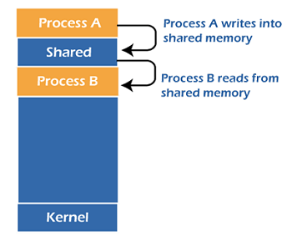
INTERPROCESS COMMUNICATION
No Kernel Intervention

Slide 50
PRODUCER-CONSUMER PROBLEM
Paradigm for cooperating processes, producer process produces information that is consumed by a consumer process
Unbounded-buffer places no practical limit on the size of the buffer
Bounded-buffer assumes that there is a fixed buffer size

Slide 51
06
IPC IN MESSAGE PASSING

Slide 52
INTERPROCESS COMMUNICATION
2. MESSAGE PASSING
In message passing, there is no use of shared memory. If two processes A and B want to communicate with each other, at first, they establish a communication link. After this, they can start exchanging messages using basic primitives. They need at least 2 basic primitives –
(a) Send (message, destination) or Send (message) (b) Receive (message, host) or Receive (message)

Slide 53
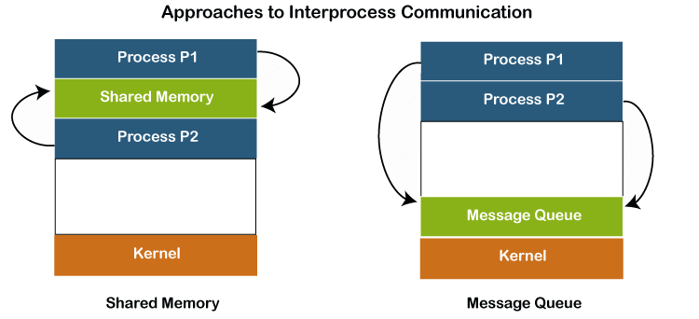
INTERPROCESS COMMUNICATION
Kernel Intervention

Slide 54
INTERPROCESS COMMUNICATION
TYPES OF MESSAGE PASSING MODEL
- Links are established through:
1. Direct or Indirect
Synchronous or Asynchronous
Buffering

Slide 55
INTERPROCESS COMMUNICATION
DIRECT
In direct message passing, receiver identity is known and message is sent directly to the receiving process. We can say that there is a link between two processes exchanging data. There cannot exist more than one link between any two processes.

Slide 56
INTERPROCESS COMMUNICATION
DIRECT
Processes must name each other explicitly:
send (P, message) – send a message to process P
receive(Q, message) – receive a message from process Q
Properties of communication link
Links are established automatically
A link is associated with exactly one pair of communicating processes
Between each pair there exists exactly one link
The link may be unidirectional, but is usually bi-directional

Slide 57
INTERPROCESS COMMUNICATION
INDIRECT
In indirect message passing, messages are sent to a mailbox (or port), which is bound to a receiving process. It differs from direct message passing, because the same mailbox could be later bound to another process. A sender doesn’t know and doesn’t care which process will actually receive its message. Additionally, multiple processes can send messages to the same mailbox, thus allowing multi-process links.

Slide 58
INTERPROCESS COMMUNICATION
INDIRECT
Operations
create a new mailbox (port)
send and receive messages through mailbox
destroy a mailbox
Primitives are defined as:
send(A, message) – send a message to mailbox A
receive(A, message) – receive a message from mailbox A

Slide 59
INTERPROCESS COMMUNICATION
SYNCHRONOUS (BLOCKING)
Blocking send -- Sender is blocked until the message is received.
Blocking receive -- Receiver is blocked until a message is available.
ASYNCHRONOUS (NON-BLOCKING)
Non-blocking send -- the sender sends the message and continue
Non-blocking receive -- the receiver receives:
- A valid message, or
- Null message
Different combinations possible
If both send and receive are blocking, we have a rendezvous

Slide 60
INTERPROCESS COMMUNICATION
BUFFERING
Queue of messages attached to the link.
implemented in one of three ways
1. Zero capacity – no messages are queued on a link. Sender must wait for receiver (rendezvous)
2. Bounded capacity – finite length of n messages Sender must wait if link full
3. Unbounded capacity – infinite length Sender never waits

Slide 61
07
COMMUNICATION IN CLIENT-SERVER SYSTEM

Slide 62
COMMUNICATION IN CLIENT-SERVER SYSTEM

